Slide 1
Fine-grained Stock Price Prediction using Deep Learning
Advisor Name: Angshuman Paul and Dweepobotee Brahma
Presentation By: Sagnik Goswami (B21AI034) and Ashutosh (B21AI007)

Slide 2
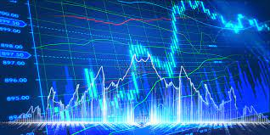
Project Deliverables
The basic aim of this project is to predict the stock price of the company using deep learning models and finding the best approach to predict stock prices of company given as an input by the user.
We performed the following tasks in our design credits project:
Used LSTM (Long Short-Term Memory) as closing stock price predictor at the very beginning and found out the best hyper-parameters for the task.
Used GRU (Gated Recurrent Unit) as closing stock price predictor and found out the best hyper-parameters for the task.
Comparative analysis of both LSTM and GRU on the same company’s data.
Trained a single model for all 50 companies in nifty-50 and then for the company given by the user as an input we fine tune the general model trained using last few day’s closing stock price data of that company.
Now, we also trained the similar model but with interval as 1 hour instead of 1 day and in this case the model will predict the opening price. Our model also performs well for companies not in nifty-50.
We predicted the range of opening stock prices for a company given as an input by the user.

Slide 3
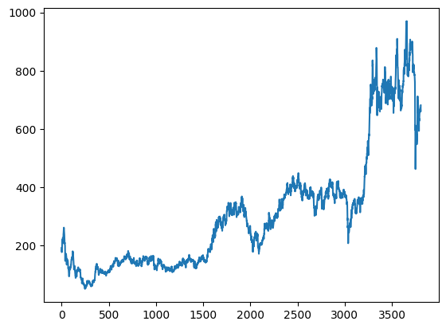
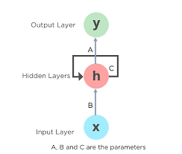
Recurrent Neural Network
Time Series Sequential data.
Different for different companies.
Patterns can be observed about relationship of next day’s price with the previous few day’s stock price.
Vanishing and Exploding Gradient Problem.
Use GRU and LSTM to avoid VG and EG.

Slide 4
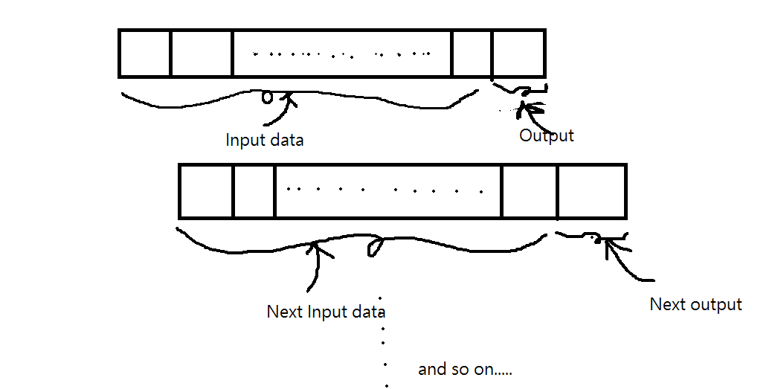

LSTM ( Long Short-Term Memory )
We train the LSTM model using the closing price of the last 1000 days of that company as an input and the output as the next day’s closing price of that company. The LSTM model performs quite well on predicting the stock prices for most of the companies
Approach:

Slide 5
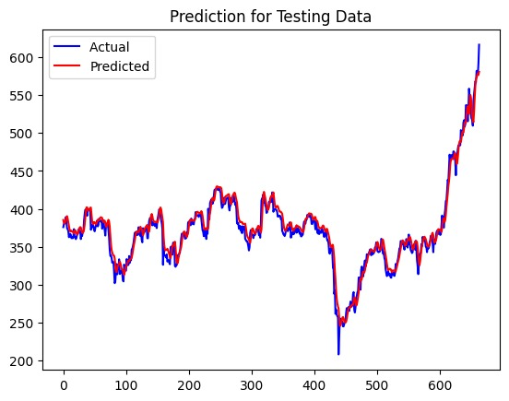
LSTM( Plot for predicted and actual stock prices(for Adani ports) )

Slide 6
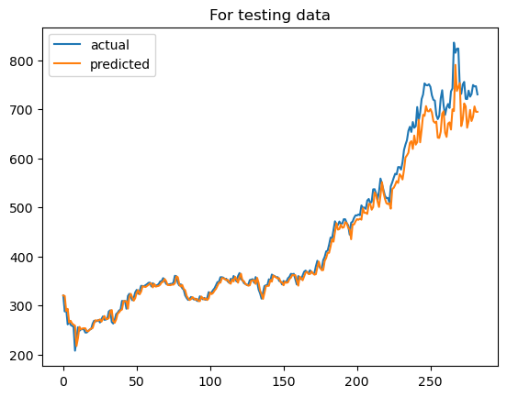
GRU ( Gated Recurrent Unit )
We follow the similar approach as in LSTM and predict the closing price of the company entered by user as input. We use GRU with the best hyper-parameters.
Plot for predicted and actual stock prices(for Adani ports) are:

Slide 7
Comparative Analysis
LSTM
Mean Squared error for testing data (for Adani ports) is 119.98379856.
Mean Squared error for validation data (for Adani ports) is 143.10944556.
GRU
Mean Squared error for testing data (for Adani ports) is 73.89147801.
Mean Squared error for testing data (for Adani ports) is 89.10397561.
Thus, considering the mean squared error we clearly see that GRU perform better than LSTM for the same company.

Slide 8
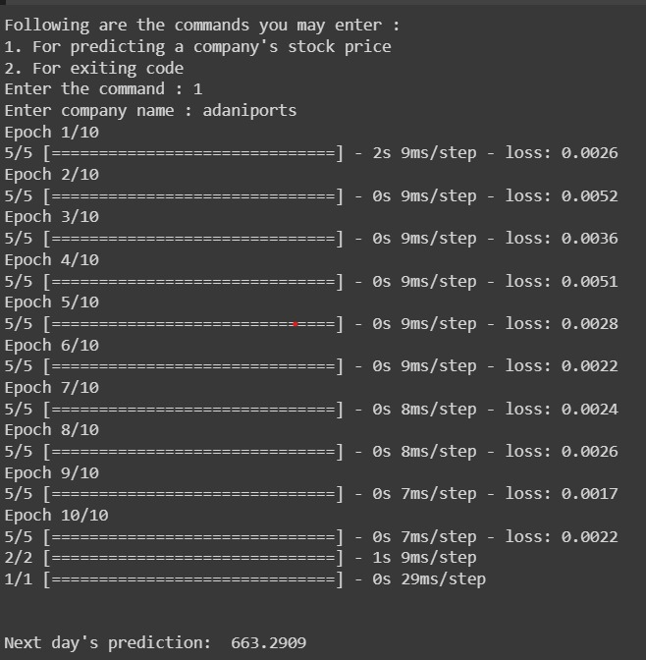
Fine-Tuning our GRU model
Till now, we trained 1 model for 1 company. Now, we generalize our idea and train a single model for all the nifty-50 companies.
We take the company name as input from the user and fine tune our model using the last 100 days closing price of that respective company.
Predicted Price: 661.30
Actual Price: 664.70
Here is our code interface:

Slide 9
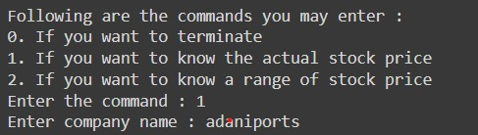

Fine-Tuning our GRU model
Now, we further improve our model to capture more complex patterns in stock prices by fine tuning the single model with prices of interval 1 hour for the company entered by user.
We observe even better results.
Predicted Opening Price: 668.91
Actual Opening Price: 667.45
Here is our code interface:

Slide 10
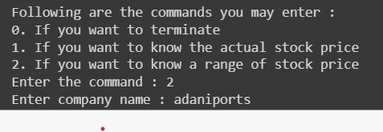
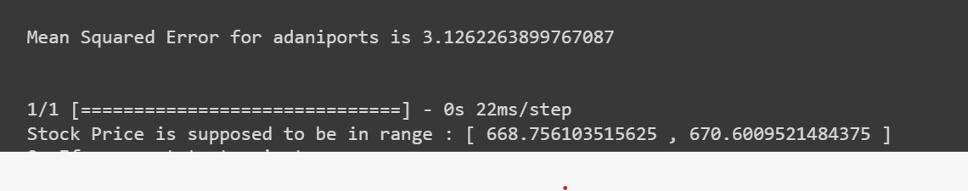
Incorporating Range
Now, we incorporate range of opening stock prices in our model using mean and standard deviation of the predicted opening price by the model in different runs.
Range Predicted : [668.75,670.61].
Actual Opening Price:
667.45
Here is our code interface:

Slide 11
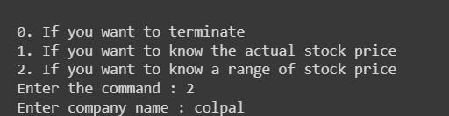
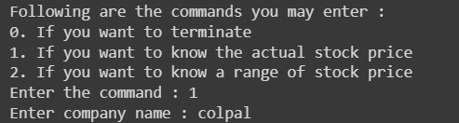
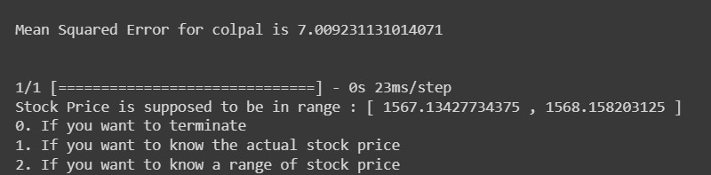
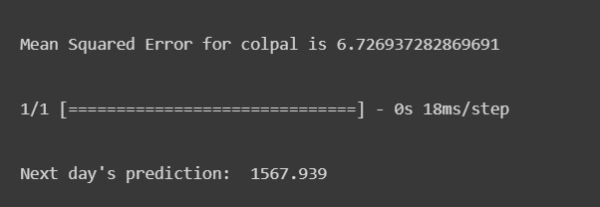
For companies not in Nifty-50
Our model also performed well for companies not in nifty-50.
Ex. Colgate
For Range of opening price:
Actual Opening Price : 1568.05
Actual Closing Price : 1574.60.

Slide 12
Conclusion
Our code gives the user option of choosing from whether he/she wants to know the exact predicted closing price of the company he/she enters or wants to know the range of values in which the stock price of the company he/she enters lies in.
The values predicted by our final model is quite close to what the actual price is of the next day be it the exact closing price prediction or range of opening price prediction.
GitHub Repository: https://github.com/sagnikCodes/Design-Credits

Slide 13
Thank You

